Slide 1
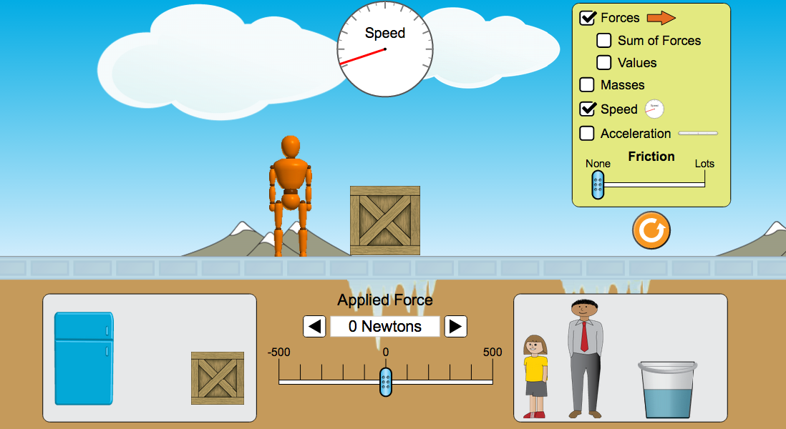
The proposed product teaches force, acceleration, velocity, work, momentum and other kinematics concepts through a simulation like the one below:

Slide 2
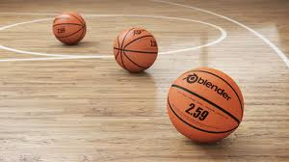
These forces will be in the context of basketballs dribbling on a court

Slide 3
The product to be developed will be an interactive kinematics tablet app which teaches all the common core kinematics unit concepts and equations for the high school common core for physics in an interactive simulation where all visualizations are in clickable, integrated layers. Visual simulations of circuit forces such as Coulomb’s Force, voltage, capacitance and magnetic force on a wire in a circuit have already been developed in some capacity by our company (Please see samples at this website http://www.lawschoolaids.com/flash_samples/index.htm). While these are not kinematics forces, many of the methods used to visualize circuit forces can be applied to visualize kinematics forces. For example, a yellow sphere around an electron which represents its potential energy in a circuit, which decreases in size as it encounters resistors in the circuit according to the appropriate physics equations, is a good model for designing a similar yellow sphere around a ball moving in the simulation which could represent its velocity or many other forces.
As the student performed touch gestures on various parts of the simulation, such as adding friction by swiping a surface, pushing a ball to move it faster or slower, dragging a ball up and then letting it fall to the ground or swiping it to knock into another ball (momentum), the visualizations of the various physical forces and their numeric values in the corresponding physics equations would alter accordingly. For example, as the student drags a basketball high up to the top of the screen, they would see the potential energy sphere around an electron increase and then decrease as they let go of the ball by releasing their finger as it falls to the ground. The opposite effect would occur to the kinetic energy sphere around the basketball as these are opposing energies. They would simultaneously see how the values of the potential and kinetic energy equations changed as this was occurring also. This way the student can understand the connection of how altering aspects of the simulation alters the physics equations visually and numerically.

Slide 4
You will do small questions as you go along and explore the circuit app on your own. You will think about what the answer is and then perform guiding exercises on the circuit to see if you’re right/what happens. Some examples of questions are:
What do you think increasing the potential energy of a ball will do when you drop it on the floor?
*The app will tell you the correct answers as you answer them as you go along using the simulation

Slide 5
You will also do some numeric physics problem solving questions and conceptual questions, during using the app and afterwards as a quiz such as:
If you increase the mass of the ball what will happen to its force, under F=ma (assume constant acceleration)?
You will get a grade and feedback on the correct answers for each quiz unit when you are finished..

Slide 6
Another description of how a student would use this app
For physics students wishing to supplement their instruction of the kinematics unit of physics, they would install the application on their tablet at home, and would use the app to learn more visually and interactively key kinematics concepts as they learned them in their kinematics unit in class. Adult supervision would not be necessary. Students could use the app anytime they wish and for however long they wanted to each session. They could also use the kinematics app to pre-learn key concepts before class, or the review concepts before exams. Students would follow audio exercises to perform guided exercises for the major kinematics concepts. They could also use the exercise book as described above and freely explore the kinematics simulation as they wished.

Slide 7
Another description of how a teacher would use this app
Physics teachers who wish to integrate this kinematics app into classroom instruction would purchase a license for all tablets in their classroom, and would watch a professional training video demonstrating how to use and implement the apps. They would also receive a teacher’s version of the exercise guidebook which would be very similar to the student’s version. There are many ways the teacher could integrate the app into classroom instruction, allowing them to maximize their creativity as instructors. They could have the students freely explore using the kinematics app before they begin their circuits unit in order to get a general idea of how all the major kinematics concepts are linked together. Then they could teach their planned lessons for this unit and have the students refer to the app and perform the guiding exercises and assessment questions for each concept in class whenever each physics concept was being taught. The students could then freely explore the circuit at the end of the unit as well after they’ve been formally taught all the physics concepts in lecture and gone through all the guiding exercises and assessment questions for the app. Teachers who allow students to take home their tablets, could also allow students to perform the guiding exercises and assessment questions for each unit as homework in preparation for teaching each physics concept in class, or alternatively as homework afterwards. The teachers would have access to all the students’ scores on their tablet version of the app for review. These are the major ways a physics teacher could supplement their classroom instruction by integrations the kinematics app into their electricity and magnetism lectures on kinematics theory.

Slide 8
Now download the assessment sheet, fill out and upload to mturk.com
Assessment can be downloaded here:
http://www.lawschoolaids.com/kinematics/

